Slide 1
OneQuesh
Team B3
Hanyu, Luke, Ting-Ann(Ann), Yuyan(Mona), Yipeng(Caroline)

Slide 2
PROGRESS REPORT (Feb 16th) - TEAM B3
Legend:
Complete
On Track
At Risk
Significant
Issues
Project | Sprint No & Ending Date | Status | Comments
OneQuesh | 02/03/2021 - 02/17/2022 |  | PMO: Yipeng Guo
Accomplishments (Past Sprint) | Next Steps (Sprint Ahead)
Set up initial proposal and ideas Meet with our BA and get insights of OneQuesh App and their database Get data from BA and set up meeting Initial analysis of data - EDA Clustering <- H-Cluster Analysis towards personal responses Wordcount Sentimental Analysis Clustering <- K-means Updated clustering adding average word count and sentimental score (Interesting findings!) | Find out what characteristics would contribute to be the most popular Quesh (continuously dig deeper) Apply Spacy to predict the popularity of questions Get the most recent Quesh pool so we can update our cluster (expected updated once per month)
Milestones | Due Date | Status
Initial analysis of Dataset | Late January
Breakdown of detailed response and expand our datasets | February 17th
Prediction Model Building Using Spacy & NN | February 24th
Mid-term presentation slides | February 28th
Mid-term Report | March 4th
(these are the milestones of the whole project, to show us the way throughout the project, not only the milestones that are reached during the project.)
Risks / Issues / Constraints
Mitigation Approach

Slide 3
What Do We Propose To Do? (Target)
With perfect understanding of that OneQuesh is still a growing company and desperate for drawing as much attention as we could, we proposed to achieve the following goals:
Dig up and understand what kind of questions gain higher popularity - find the common ground!
Build model to predict and pick up those ‘will-be-popular’ questions
…
Post! 😊

Slide 4
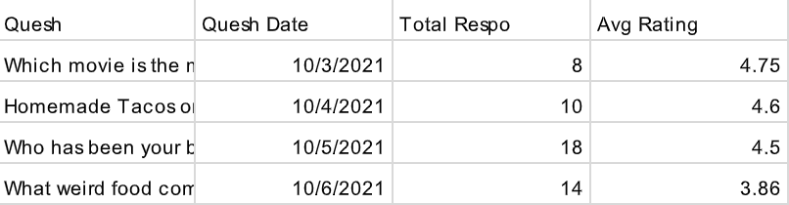
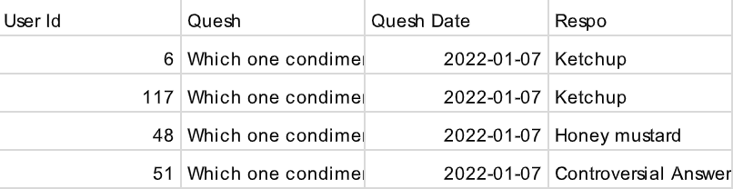
What Data Do We Have For Now?
Question Data
Response Date

Slide 5
What Are Our Hypothesis?
Hypo 1:
Popular (interesting) Quesh may have more responses
Hypo 2:
Popular Quesh may initiate people to talk more (more character)
Hypo 3:
Popular Quesh may have more positive responses (higher sentiment score)

Slide 6
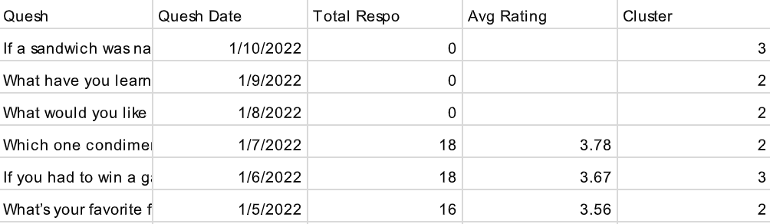
What Did We Do To Get Insights?
Label The Quesh (Type)
This or that - 1
What is -2
Hypothetical -3

Slide 7
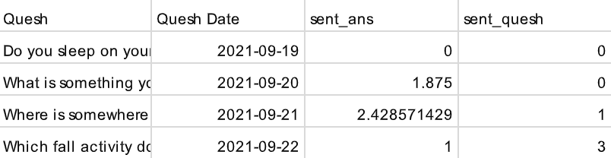
What Did We Do To Get Insights?
2. Apply Text Analysis - Sentiment Score
Every single response will have its sentiment score
Group by Quesh and get the average sentiment score for each Quesh
Get sentiment score for Quesh for further use

Slide 8
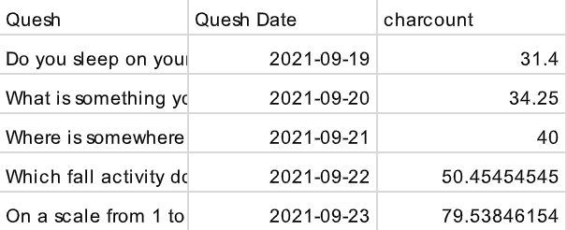
What Did We Do To Get Insights?
3. Apply Text Analysis - Character Count
Every response have its character count
Group by Quesh and get the average character count for each Quesh

Slide 9
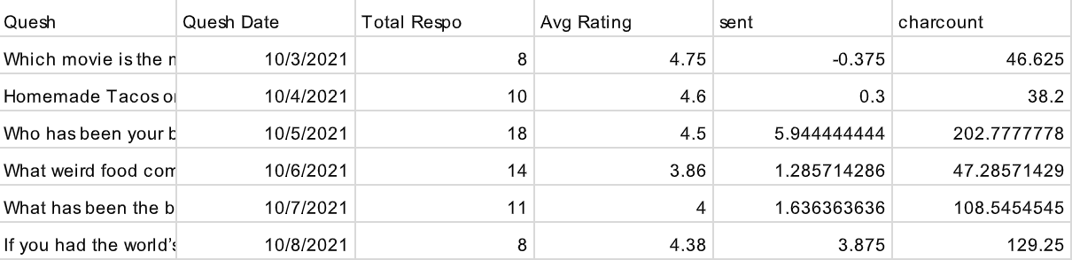
After That… We Have the Featured Dataset

Slide 10
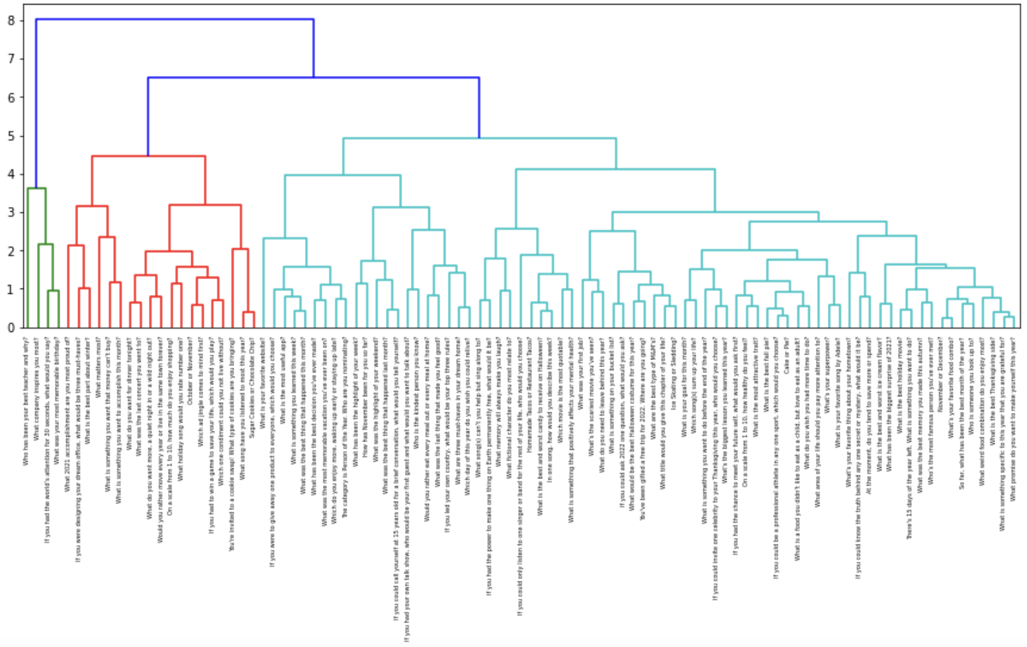
Based On That Featured Dataset
Do H-Clustering!
19
4
74

Slide 11
Based On That Featured Dataset
Do H-Clustering!
Cluster | Total Respo | Avg Rating | Sentiment Score | Character Count
1 | 10.50 | 4.42 | 4.83 | 156.07
2 | 21.84 | 3.72 | 1.40 | 54.83
3 (Moderate) | 13.31 | 4.15 | 1.55 | 63.49
Try to find specialties of the cluster-1 Quesh and generate more
Adjust the cluster-2 Quesh, maintain level of response and increase other scores
Build prediction model afterwards (Spacy, NN, CV ect)

Slide 12
Data Request Next Step
1. Quesh Bank
2. Update Data Frequently
For us to test our model and find the ‘wil-be-popular’ ones
For us to fill in the blanks, considering every single point can change the whole map

